Slide 1

ICUDDR
World Mental Health International College Student Project (WMH-ICS)

Slide 2
Center for Excellence on
Research in Mental Health
CES University, Medellín Colombia
Yolanda Torres de Galvis

Slide 3
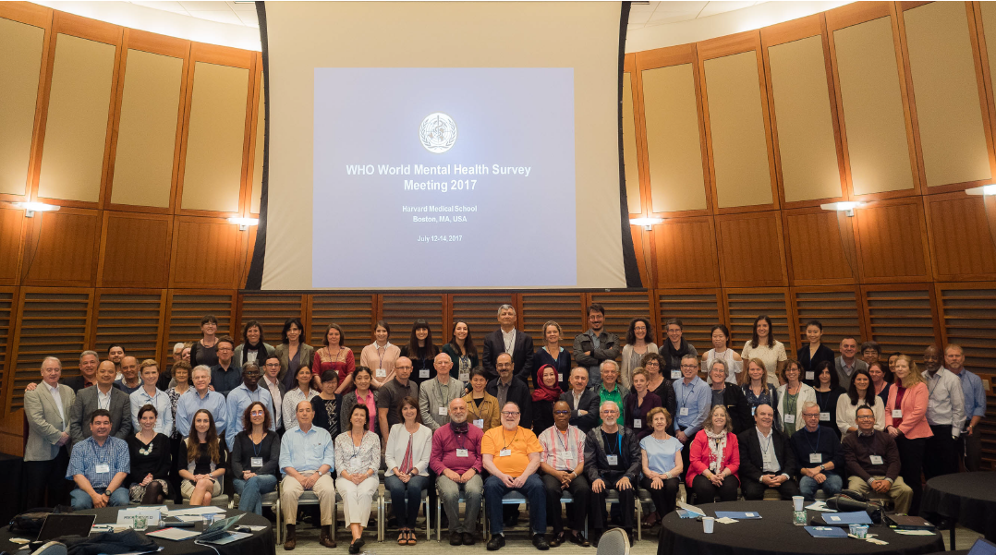

Slide 4
BACKGROUND
College students are a key group in society in terms of human capital as they play a major role in future economic growth and innovation.
Abel & Deitz, 2012)
Most lifetime mental disorders begin in childhood or adolescence and the college years are consequently a peak period for prevalence of recent mental disorder. (Kessler, Amminger, et al.,2007)

Slide 5
BACKGROUND
Mental disorders have a substantial impact on academic performance.
(Auerbach et al., 2016; Kessler,Foster, Saunders, & Stang, 1995)
And prematriculation onset disorders are strong predictors of college attrition.
(Auerbach et al., 2016)
Therefore, it is important to detect and treat mental disorders when they exist among college students

Slide 6
Impairment due to mental disorders among college student
Recently it has been reported a high prevalence of severe role impairment in first‐year college students.
(Alonso et al., 2018)
About three quarters (74.6%) of students reported at least some health‐related role impairment in one of the four domains SDS: 45.3% home, and 61.6% social.

Slide 7
Impairments were most consistently associated with major depression, panic disorder, and ADHD after adjusting for class membership.
This association is consistent with evidence for the special importance of these disorders in previous surveys among students. (Vergeret al., 2010)

Slide 8
The high prevalence of comorbid mental disorders among college students creates a challenge for treatment.
Only 24.6% of students reported that they would definitely seek treatment if they had a future emotional problem.
Innovative e‐therapies are available that might be useful in diminishing role impairment among university college students.

Slide 9
The college years are a develop mentally crucial period for young people in which they transition from late adolescence to emerging adulthood.
“Considering that students are a key population for determining the economic success of a country, colleges must take a greater urgency in addressing this issue.” Arnett, 2000.

Slide 10
Indicadores de Salud Mental Estudiantes
World Mental Health International College Student Project (WMH-ICS)
https://www.hcp.med.harvard.edu/wmh/college_student_survey.php

Slide 11
1
It is a challenge for universities to determine, how to identify college students for outreach and treatment of existing mental disorders or for preventive interventions when at high risk of mental disorders and, once identified.
2
And how to offer services to the very large proportion of students likely to profit from either treatment or preventive interventions.
3
Internet- College Mental Health based cognitive behavior therapy (CBT), which has been shown to have effects equivalent to those of face-to-face CBT

Slide 12
Methods
The World Health Organization World Mental Health International College Student (WMH‐ICS) initiative is aimed at developing and implementing a system for improving prevention and early interventions for mental health problems among college student. college studen

Slide 13
The WMH-ICS is designed to: generate accurate epi-demiological data on unmet for treatment of mental, substance, and behavioral disorders among college students worldwide.
Implement and evaluate web-based interventions for and treatment of these disord both the prevention.
And disseminate the evidence-based interventions, to improve targeting of interventions, using precision medicine procedures.

Slide 14
The initiative consists
of three core elements.

Slide 15
The first element
Is a e-survey to assess:
The magnitude and nature of emotional problems.
The effects of these problems on students' functioning
And barriers to seeking treatment.
All first‐year students in participating colleges are invited to participate.

Slide 16
The second element
Is an infrastructure to test internet‐ based interventions aimed at the prevention and early intervention in mental health problems.
Participating colleges can develop and test internet‐based interventions in randomized trials.

Slide 17
The third element
Test internet‐based interventions in randomized trials.
The element is the dissemination and continuous quality improvement monitoring of the evidence‐based interven-tions developed in WMH‐ICS.
Internet- College Mental Health based cognitive behavior therapy (CBT), which has been shown to have effects equivalent to those of face-to-face CBT

Slide 18
By addressing these three core elements, the WMH‐ICS aims to integrate epidemiological and clinical research to offer scalable and effective evidence based interventions for mental health problems at a critical life course stage.

Slide 19
WMH-ICS
FIRST RESULTS

Slide 20
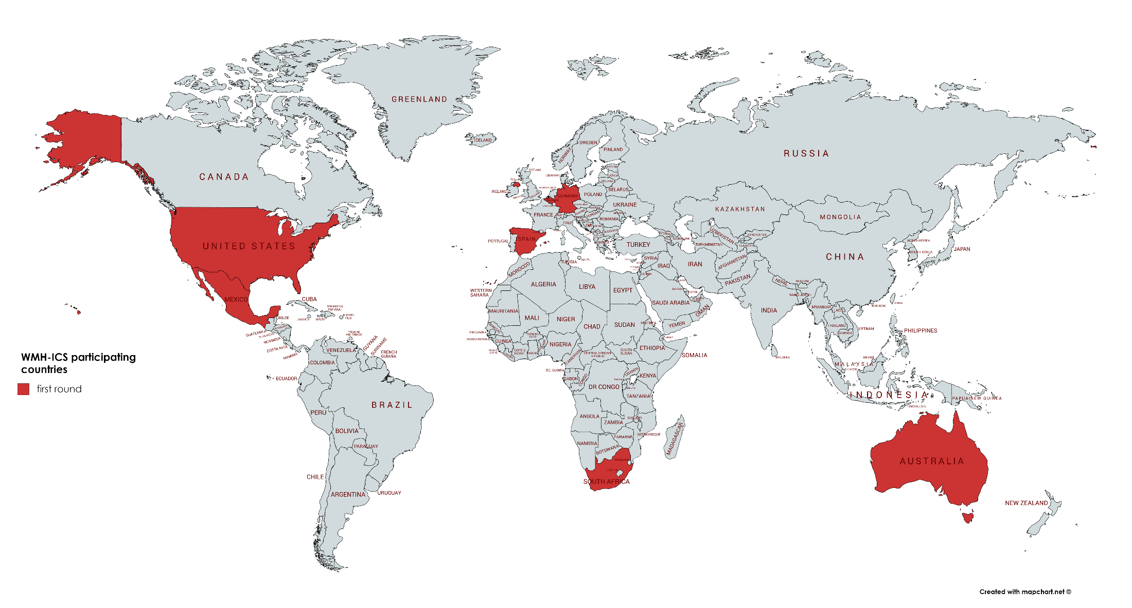
WMH-ICS first round
Australia – Penelope Hasking
Belgium – Ronny Bruffaerts
Germany – David Ebert
Mexico – Corina Benjet
Northern Ireland – Siobhan O’Neill
South-Africa – Dan Stein
Spain – Jordi Alonso
USA – Randy Auerbach

Slide 21
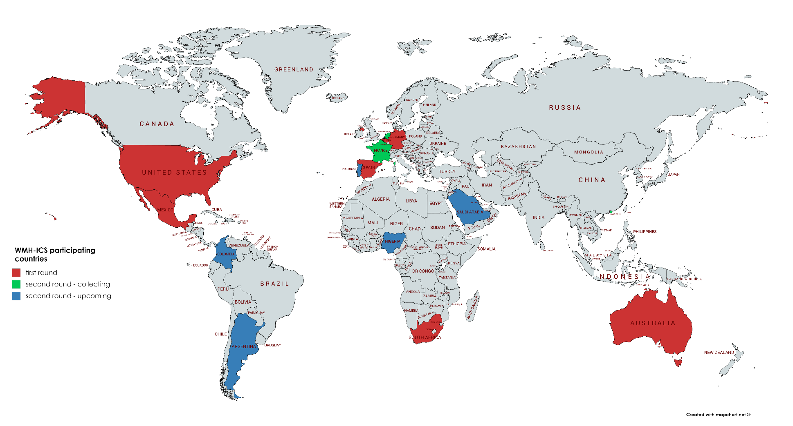
WMH-ICS second round
Argentina – Daniel Vigo
Colombia –Yolanda Torres
France – Mathilde Husky
Hong-Kong – Arthur Mak
The Netherlands – Pim Cuijpers
Nigeria – Oye Gureje
Portugal - José Miguel Caldas-de-Almeida
Saudi-Arabia – Yasmine Altwaijri

Slide 22
WHO WMH-ICS Project:
Prevalence, Distribution, and Risk Profiles
Randy P. Auerbach, Ph.D., ABPP
July 12, 2018
Auerbach, R. P., Mortier, P., Bruffaerts, R., Alonso, J., Benjet, C., Cuijpers, P., Demyttenaere, K.,
Ebert, D. D., Green, J. G., Hasking, P., Murray, E., Nock, M. K., Pinder-Amaker, S., Sampson, N. A.,
Stein, D. J., Vilagut, G., Zaslavsky, A. M., Kessler, R. C., & WHO WMH-ICS Collaborators (2018,
September 13). WHO World Mental Health Surveys International College Student Project:
Prevalence and Distribution of Mental Disorders. Journal of Abnormal Psychology. Advance online
publication. http://dx.doi.org/10.1037/abn000036

Slide 23
Mental Disorders in First Year Students
13,984 students - 19 colleges and universities - eight countries
Notes:
-A total of 14,371 questionnaires were completed, with sample sizes ranging from a low of 633 in Australia to a high of 4,580 in Belgium.

Slide 24
Mental Disorder Age-of-Onset
13,984 students - 19 colleges and universities - eight countries

Slide 25
Severa role impairment associated with mental disorders: Results of the WHO World Mental Health Surveys International College Student Project
Jordi Alonso MD, PhD Philippe Mortier PhD Randy P. Auerbach PhD Ronny Bruffaerts PhD Gemma Vilagut PhD Pim Cuijpers PhD Koen Demyttenaere David D. Ebert PhD Edel Ennis PhD9 Raul A. Gutiérrez-García PhD Jennifer Greif Green PhD Penelope Hasking PhD Christine Lochner MA, PhD Matthew K. Nock PhD Stephanie Pinder-Amaker PhD Nancy A. Sampson BA, Alan M. Zaslavsky PhD Ronald C. Kessler PhD WHO WMH -ICS Collaborators1

Slide 26
Severe role impairment by 12-month mental disorder, WMH-ICS (%)
 | Whole Sample | Any severe role Impairment | Home magmnt | College related work | Close relations | Social life
Full sample (n = 13,984) | 100 | 20.4 | 6.6 | 9.6 | 11.1 | 12.1
No disorder | 68.6 | 10.0 | 3.3 | 4.1 | 4.8 | 5.4
Any m disorder | 31.4 | 42.9 | 13.7 | 21.7 | 24.8 | 26.8
Type:
MDE | 18.5 | 51.2 | 16.7 | 27.4 | 30.9 | 33.3
GAD | 16.7 | 53.1 | 18.1 | 27.8 | 30.6 | 34.8
Panic disorder | 4.5 | 60.6 | 24.4 | 35.2 | 32.4 | 37.6
Broad mania | 3.1 | 57.5 | 24.5 | 32.9 | 35.7 | 35.3
Alcohol A/D | 6.3 | 34.2 | 13.0 | 15.7 | 19.4 | 21.4
Drug A/D | 3.0 | 48.4 | 22.3 | 25.8 | 31.5 | 23.9
#Disorders
1 | 17.2 | 30.2 | 7.6 | 13.7 | 16.4 | 17.5
2 | 9.4 | 52.9 | 16.7 | 26.9 | 32.0 | 35.0
3+ | 4.8 | 68.8 | 29.4 | 40.1 | 40.7 | 43.8

Slide 27
Severe role impairment by 12-m disorder & country. WMH-ICS (%)
 | Australia | Belgium | Germany | Mexico | N- Ireland | South Africa | Spain | USA
Full sample | 38.7 | 10.6 | 27.4 | 8.9 | 22.2 | 20.9 | 17.3 | 17.0
Any disorder | 16.9 | 5.6 | 15.1 | 5.4 | 9.8 | 11.2 | 9.7 | 9.3
Any m disorde | 67.2 | 31.9 | 48.9 | 20.0 | 43.4 | 41.3 | 32.6 | 37.8
Tipe
MDE | 75.4 | 41.6 | 51.6 | 27.5 | 52.0 | 48.6 | 38.8 | 50.6
GAD | 78.1 | 43.8 | 58.7 | 29.0 | 52.5 | 47.6 | 39.9 | 43.7
Panic disorder | 75.1 | 37.9 | 65.5 | 28.6 | 62.5 | 57.7 | 71.4 | 46.0
Broad mania | 79.5 | 59.1 | 55.2 | 27.5 | 49.3 | 44.6 | 57.8 | 62.1
Alcohol A/D | 69.5 | 17.7 | 48.9 | 15.2 | 33.4 | 34.6 | 26.8 | 12.9
Drug A/D | 68.8 | 26.8 | 66.3 | 27.5 | 55.8 | 43.9 | 37.4 | 21.6
# Disordes
Exactly 1 | 44.6 | 22.3 | 38.0 | 12.3 | 29.9 | 32.7 | 22.5 | 33.6
Exactly 2 | 81.6 | 44.1 | 62.2 | 29.4 | 51.4 | 47.5 | 41.3 | 38.0
Exactly 3 + | 83.8 | 70.5 | 68.6 | 41.0 | 67.6 | 56.6 | 61.6 | 69.0

Slide 28
Twelve-month mental disorders as predictors for types of severe role impairment College-related work WMH-ICS surveys, final model
 | OR | OR (95%CI)
TYPE OF DISORDER
Major depressive episode | 3.6 | 2.8 – 4.6*
Generalized anxiety disorder | 3.5 | 2.7 – 4.7*
Panic disorder | 3.0 | 2.0 – 4.4*
Broad mania | 2.3 | 1.6 – 3.4*
Alcohol abuse or dependence | 1.4 | 1.0 – 1.9
Drug abuse or dependence | 2.3 | 1.5 – 3.5*
PARP % (SE) | 50.4
1 : 3.6

Slide 29
Mental disorder comorbidity and suicidal thoughts and behaviors in the World Health Organization World Mental Health Surveys International College Student initiative
Randy P. Auerbach | Philippe Mortier | Ronny Bruffaerts | Jordi Alonso | Corina Benjet | Pim Cuijpers | Koen Demyttenaere | David D. Ebert | Jennifer Greif Green| Penelope Hasking | Sue Lee | Christine Lochner | Margaret McLafferty | Matthew K. Nock| Maria V. Petukhova | Stephanie Pinder‐Amaker | Anthony J. Rosellini | Nancy A. Sampson | Gemma Vilagut | Alan M. Zaslavsky | Ronald C. Kessler9 | on behalf of the WHO WMH‐ICS Collaborators

Slide 30
Sociodemograph risk factors with 12‐month STBs
OR
Men 1,0
Female 1,5
Trans, other 12,6
Sexual orientation
Heterosexual: no same‐sex attraction 1,0
Heterosexual: some same‐sex attraction 4,0
Non heterosexual without same‐sex sexual intercourse 16,0
Non heterosexual with same‐sex sexual intercourse 14,5
Most important reason to go to college extrinsic 2.4

Slide 31
Conclusions

Slide 32
Indicadores de Salud Mental Estudiantes
Correlates for Any Mental Disorder in the WMH-ICS Surveys
RD
Sexual orientation
Heterosexual: no same-sex attraction 1,0
Heterosexual: some same-sex attraction 1.8 [1.5, 2.1]
Nonheterosexual without same-sex
sexual intercourse 2.6 [2.1, 3.3]
Nonheterosexual with same-sex
sexual intercourse 2.8 [2.3, 3.

Slide 33
The finding of a third of students from multiple countries and cultures had positive results for at least one of six mental disorders represents a key problem in global mental health.
A strong association between disability and mental disorders was found:
  Almost half of this disability can theoretically be avoided by treating these disorders.
Disability is very frequent among students and strongly affects the academic area.

Slide 34
The resources of the Universities are finite, therefore the groups must be identified according to risk level and thus achieve.
Comorbidity is the rule
The focus of the treatment should be based on the diagnosis.
But, most treatment approaches are guided by the single diagnosis.

Slide 35
Conclusion……
The finding of a third of students from multiple countries and cultures had positive results for at least one of six mental disorders represents a key problem in global mental health.
In line with prior research, comorbid mental disorders were common.

Slide 36
It was a pleasure to share with you about this important theme.
Yolanda Torres

Slide 37

La motivación más importante para investigar, es el placer en su resultado y el valor de dicho resultado para la Humanidad.
Albert Einstein

